Slide 1

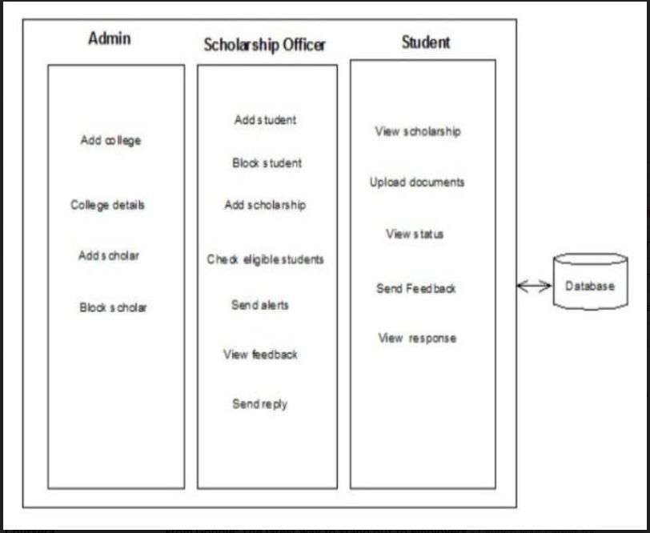
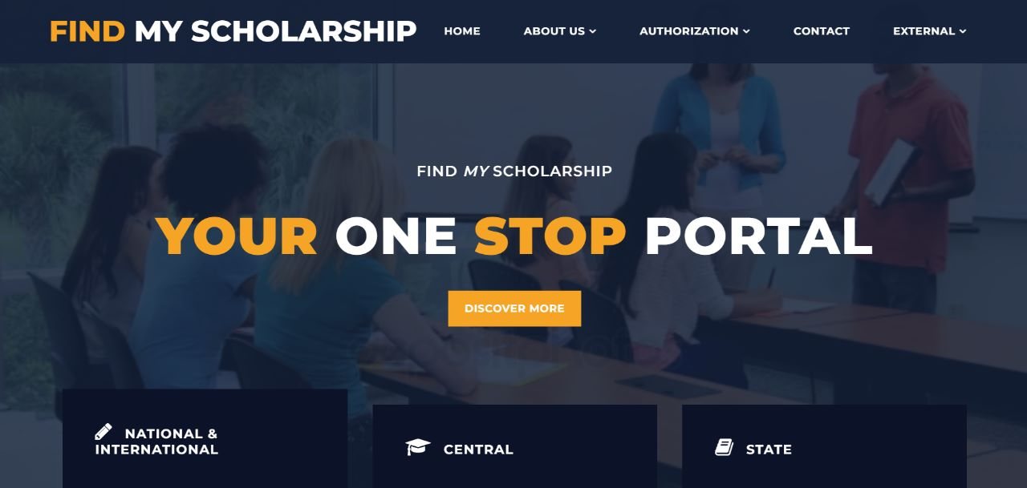
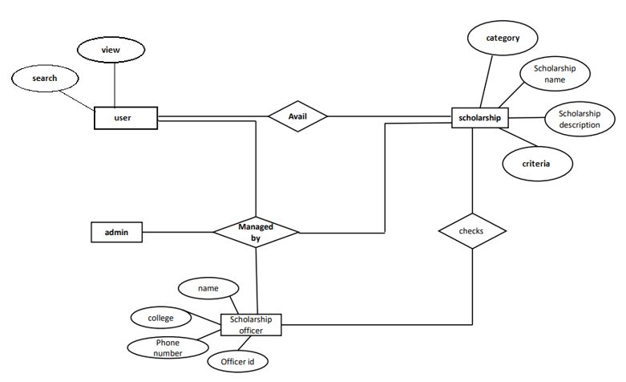
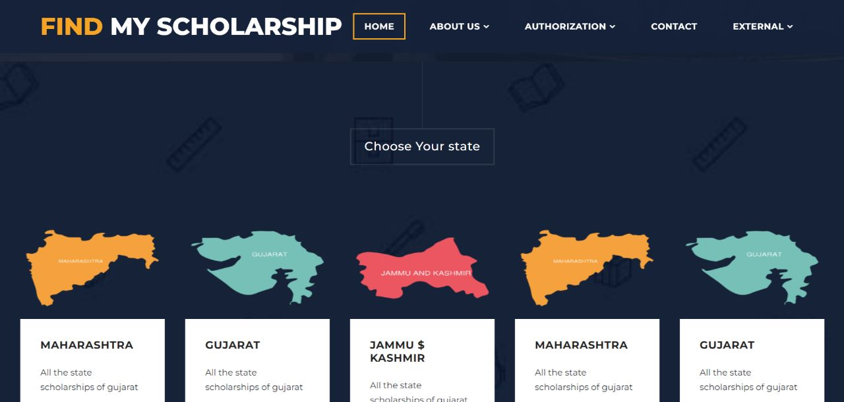
FIND MY SCHOLARSHIP
AANCHAL PATEL, ADITI RATHORE , ADITYA KUMAR SONI
INTRODUCTION
METHODS
RESULTS
CONCLUSION
The online web-based application allows the user to apply for a scholarship. The portal is user friendly and allows the user to easily navigate through different scholarships and consider the most appropriate scholarship based on the information provided. Portal mainly divides scholarships into four
categories that are central, state,
international and private that can be smoothly accessed by the users based on their requirements.
Apart from the other facilities it also provides ease of data entry for the user. All the requirements projected by the user have been met by the system. The newly developed system consumes less processing time and all the details are updated and processed immediately. Since
the screen provides real time help messages and is very user friendly, any user can get familiarized.
An online scholarship portal that will provide information about various scholarships available for students.
The portal’s primary uses include tracking the status of scholarship to be had and viewing data in regard to scholarships and applicants.
• Analysing all the government website and third party websites.
• Collecting all the useful designs , data from the above websites.
• Developing a website with all the crisp data and exact links
• Tailoring end user experience with cross platform capatability .
REFERENCE
OBJECTIVE
Textbook References:
XML - XML complete reference by Aaron Skonnard & Martin Gudgin
HTML - Steven Holzner AJAX - JavaScript and Ajax for the web, Sixth Edition (Visual Quick Start Guide)
Modern Web Design Using JavaScript and DOM by Stuart Landgridge
Websites:
www.google.com, www.asp.net
www.ajaxprojects.com, www.w3schools.com
www.programmingtutorials.com, www.youtube.com
The project “Find my scholarship” is a software package developed maintaining scholarships for different categories , checking eligibility criteria for each scholarship. The software is very helpful to find the eligible candidates from different colleges.
TECHNOLOGY USED
❖HTML & CSS : Providing basic structure to the website.
❖Bootstrap: Styling of website is done by Bootstrap.
❖Java script : Providing dynamic interface to the user
❖My Sql & PHP: For maintaining the database of the website
CONTACTS
Aanchal Patel
aanchalpatel20538@acropolis.in
Aditi Rathore
aditirathore20640@acropolis.in
Aditiya K. Soni
aditiyasoni20891@acropolis.in
Department of Computer Science and Engineering,AITR

